Slide 1
The MAHIVE Project
Building IoT Security

Slide 2
The Project
Correlate physical and digital events for total security
Focus on individual sensors which perform initial data collection
Hub device to relay sensor information to MAHIVE server
Modular system that can adapt to many situations or buildings

Slide 3
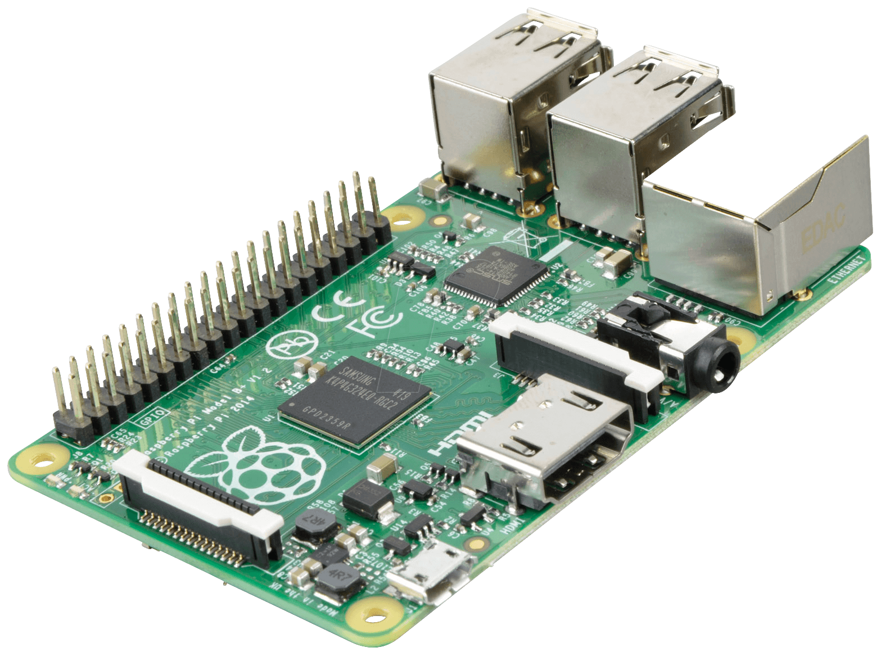
Project Objective
Authenticate to a cloud-based server using asymmetric encryption
Establish encrypted communication
Use JSON or TRDF to encode and send data
Prove this concept is viable

Slide 4
Value
Track both cyber and physical threats at the same time
Easily scalable
Easy to integrate into already existing environments

Slide 5
Expanded Value Proposition
Hacking ever-increasing threat; industry needs way to defend itself physically and digitally
Merge cyberphysical and cybersecurity solutions into one platform; correlate physical and digital events
Team TBD task: create hub controller to link IoT devices, consolidate reports into a JSON/RDF format, encrypt, securely send using advanced authentication and encryption

Slide 6
Customers
Who can use this?
Government SCIF centers
SOC and Server room
Hospitals, Prisons, and Military Bases
Secure nuclear facilities
INL, PNNL, Hanford, and more

Slide 7
Design Constraints
Design must be low-cost
No elaborate, costly solutions (goal for sensors: <$50)
Design must use off-the-shelf parts/boards
Raspberry Pi, etc.
Use simple sensory parts readily available online
Sensors should be able to run off battery power
Board should have low power consumption
Interrupts rather than polling
Sensor device should be small & easily placed inside building

Slide 8
Product Requirements
Product must utilize public-key infrastructure to authenticate itself
Product must encrypt messages that are transmitted
Event data must be sent in JSON/RDF format

Slide 9
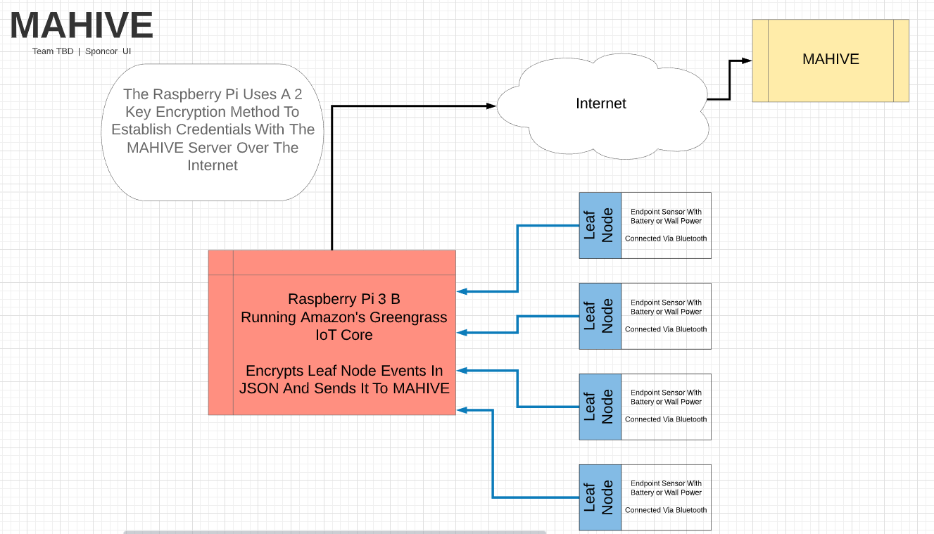
Flow Diagram

Slide 10
Costs and Budget
Indented Bill of Materials (BOM) |  |  | Manufacturing Plan |  |  |  |  |  |  | Cost
Part No. or Assy No. | Description | Quantity | Make or Buy? | Source (or Fabrication Location) | Fabrication Technique (if appl.) | Is the Drawing Avail.? | Is the Material Avail.? | Who will lead (Name)? | Target Completion Date | Unit Cost ($) | Extended Cost ($)
Hub device | Raspberry Pi | 1 | Buy | Amazon.com |  | Yes | Yes | Tristan | 1-Feb | $38.98 | $38.98
Part 1 | Case | 1 | Buy | Amazon.com |  |  | Yes |  |  | $6.50 | $6.50
Part 2 | SD card | 1 | Buy | Amazon.com |  |  | Yes |  |  | $5.79 | $5.79
Part 3 | Power adapter | 1 | Buy | Amazon.com |  |  | Yes |  |  | $8.57 | $8.57
Sensor | Esp32 DevkitC | 2 | Buy | Amazon.com |  | Yes | Yes | Jared | 1-Apr | $7.33 | $14.65
Part 4 | Battery Pack | 2 | Buy | Amazon.com |  |  | Yes |  |  | $10.00 | $19.99
Part 5 | Door Sensor | 1 | Buy | Adafruit |  |  | Yes |  |  | $3.95 | $3.95
Part 6 | Light Switch | 1 | Buy | Moscow Building Supply |  |  | Yes |  |  | $4.10 | $4.10
Part 7 | Breadboard | 2 | Buy | Amazon.com |  |  | Yes |  |  | $2.00 | $4.00
Insert more lines as needed…
 |  |  |  |  |  |  |  |  |  | Total BOM Cost | $106.53

Slide 11
Project Progress to Date
Decided on hardware to use
Hub Device: Raspberry Pi 3
Leaf devices: ESP32
Ordered Parts/Devices
ESP32
Raspberry Pi
Sensors/switches
Breadboards, wires, etc.
Battery Packs

Slide 12
Project Progress
ESP32: flashed with Amazon FreeRTOS, running Greengrass Connectivity Demo
Discovers local hub device
Authenticates on AWS
Sends MQTT message to AWS cloud via hub device
Raspberry Pi
Running Greengrass Core software
Deployed as hub device with potential for C/Python lambda functions
Communicates directly with AWS cloud

Slide 13

Potential Future Work
Implement sensors on individual IoT devices, rather than having them wired directly to the hub device
Utilize Amazon FreeRTOS on edge device(s) in conjunction with AWS Greengrass Core
Robust data storage destination for sensor data
Outside of this project’s scope
Evaluate whether to continue with use of AWS platform
May desire to limit dependence on Amazon, especially in educational context
May be complicated to build up from scratch

Slide 14
THANK YOU
Does anyone have any questions?

Slide 15

Thank You

Slide 16
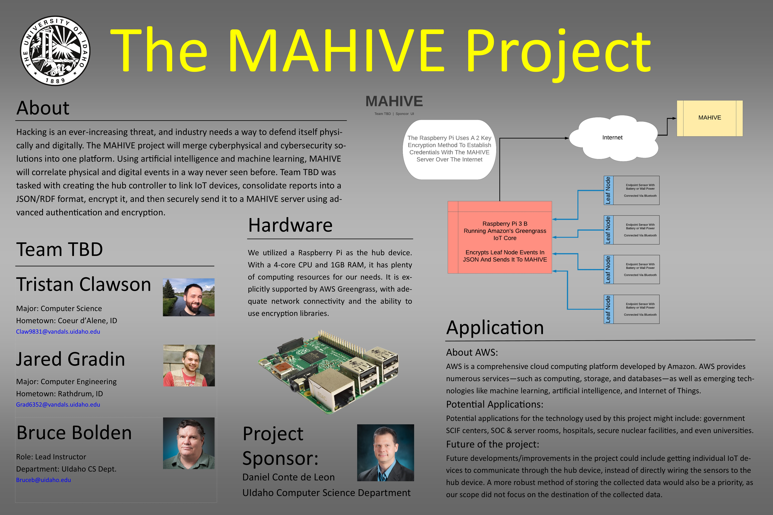

Slide 17
Remaining Project Schedule
After Spring Break: FreeRTOS modified sufficiently to utilize sensors on ESP32
End of March: Full working sensor relaying data in proper format to cloud, able to display on computer
Early April: Print Poster for project
End of April: Demo setup with 2X ESP32 door/light sensors, Pi hub, computer, etc. Finished & ready for expo

Slide 18
Potential Decisions
Possibility that learning/modifying FreeRTOS is too complicated/time consuming for scope of this project
Could modify demo project for sake of proof-of-concept
Decision may have to be made between power consumption and reliability of sensors
Sensor reliability more important
If interrupts cannot be used, can implement polling and wall power instead
May run into issues formating sensor data into TRDF format

